Slide 1

Annual Conference
Report
* 2013 *

Slide 2


Slide 3
Reading Response:
Ecclesiastes 9:7-10
Leader: Seize life!
Eat bread with gusto,
Drink wine with a robust heart.
Oh yes—God takes pleasure
in your pleasure!
ALL: Whatever you do,
do for the glory of God.

Slide 4
Leader: Dress festively every morning.
Don’t skimp on colors and scarves.
Relish life with the spouse you love
Each and every day
of your precarious life.
ALL: Whatever you do,
do for the glory of God.

Slide 5
Leader: Each day is God’s gift.
It’s all you get in exchange
For the hard work of staying alive.
Make the most of each one!
Whatever turns up,
grab it and do it. And heartily!
ALL: Whatever you do,
do for the glory of God.

Slide 6
Leader: This is your last
and only chance at it,
For there’s neither work to do
nor thoughts to think
In the company of the dead,
where you’re most certainly headed.
ALL: Whatever you do,
do for the glory of God.

Slide 7
Leader: I took another walk around the neighborhood and realized
that on this earth as it is—
The race is not always to the swift,
Nor the battle to the strong,
Nor satisfaction to the wise,
Nor riches to the smart,
Nor grace to the learned.
Sooner or later bad luck hits us all.
ALL: Whatever you do,
do for the glory of God.

Slide 8
Leader: No one can predict misfortune.
Like fish caught in a cruel net
or birds in a trap,
So men and women are caught
By accidents evil and sudden.
ALL: Whatever turns up,
grab it, and do it heartily!
Whatever you do,
do for the glory of God.

Slide 9
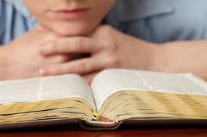
Bless the Lord,
O my soul, O my soul
Worship His holy name
Sing like never before
O my soul
I'll worship Your holy name

Slide 10
The sun comes up, it's a new day dawning
It's time to sing Your song again

Slide 11
Whatever may pass, and whatever lies before me
Let me be singing when the evening comes

Slide 12
Bless the Lord,
O my soul, O my soul
Worship His holy name
Sing like never before
O my soul
I'll worship Your holy name

Slide 13
You're rich in love, and You're slow to anger
Your name is great, and Your heart is kind

Slide 14
For all Your goodness I will keep on singing
Ten thousand reasons for my heart to find

Slide 15
Bless the Lord,
O my soul, O my soul
Worship His holy name
Sing like never before
O my soul
I'll worship Your holy name
Bless you Lord

Slide 16
And on that day when my strength is failing
The end draws near and my time has come

Slide 17
Still my soul will sing Your praise unending
Ten thousand years and then forevermore , forevermore

Slide 18
Bless the Lord,
O my soul, O my soul
Worship His holy name
Sing like never before
O my soul
I'll worship Your holy name
(REPEATS ONCE MORE)

Slide 19
Yes I’ll, I'll worship Your holy name
Lord, I'll worship Your holy name

Slide 20
Sing like never before
O my soul
I'll worship Your holy name

Slide 21
Jesus, I'll worship Your holy name
Worship Your holy name

Slide 22
Whatever your hand finds to do, do it with all your might.
-Ecclesiastes 9:10a

Slide 23


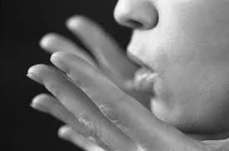
Types of
Prayer

Slide 24
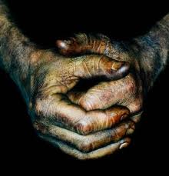
Announcements
The Lord’s Prayer

Slide 25
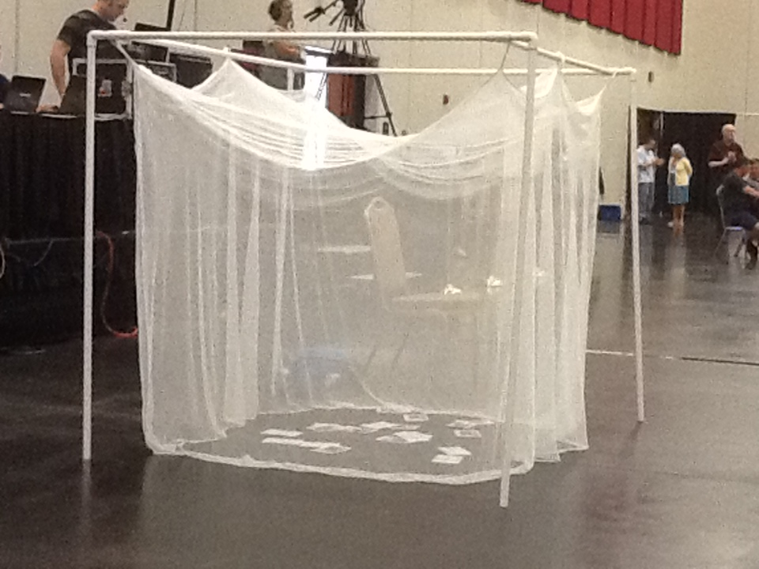
Imagine No Malaria
Received:
$34,228.52
District Pledge:
$200,000

Slide 26
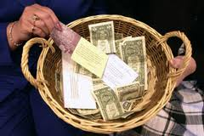
Offering

Slide 27
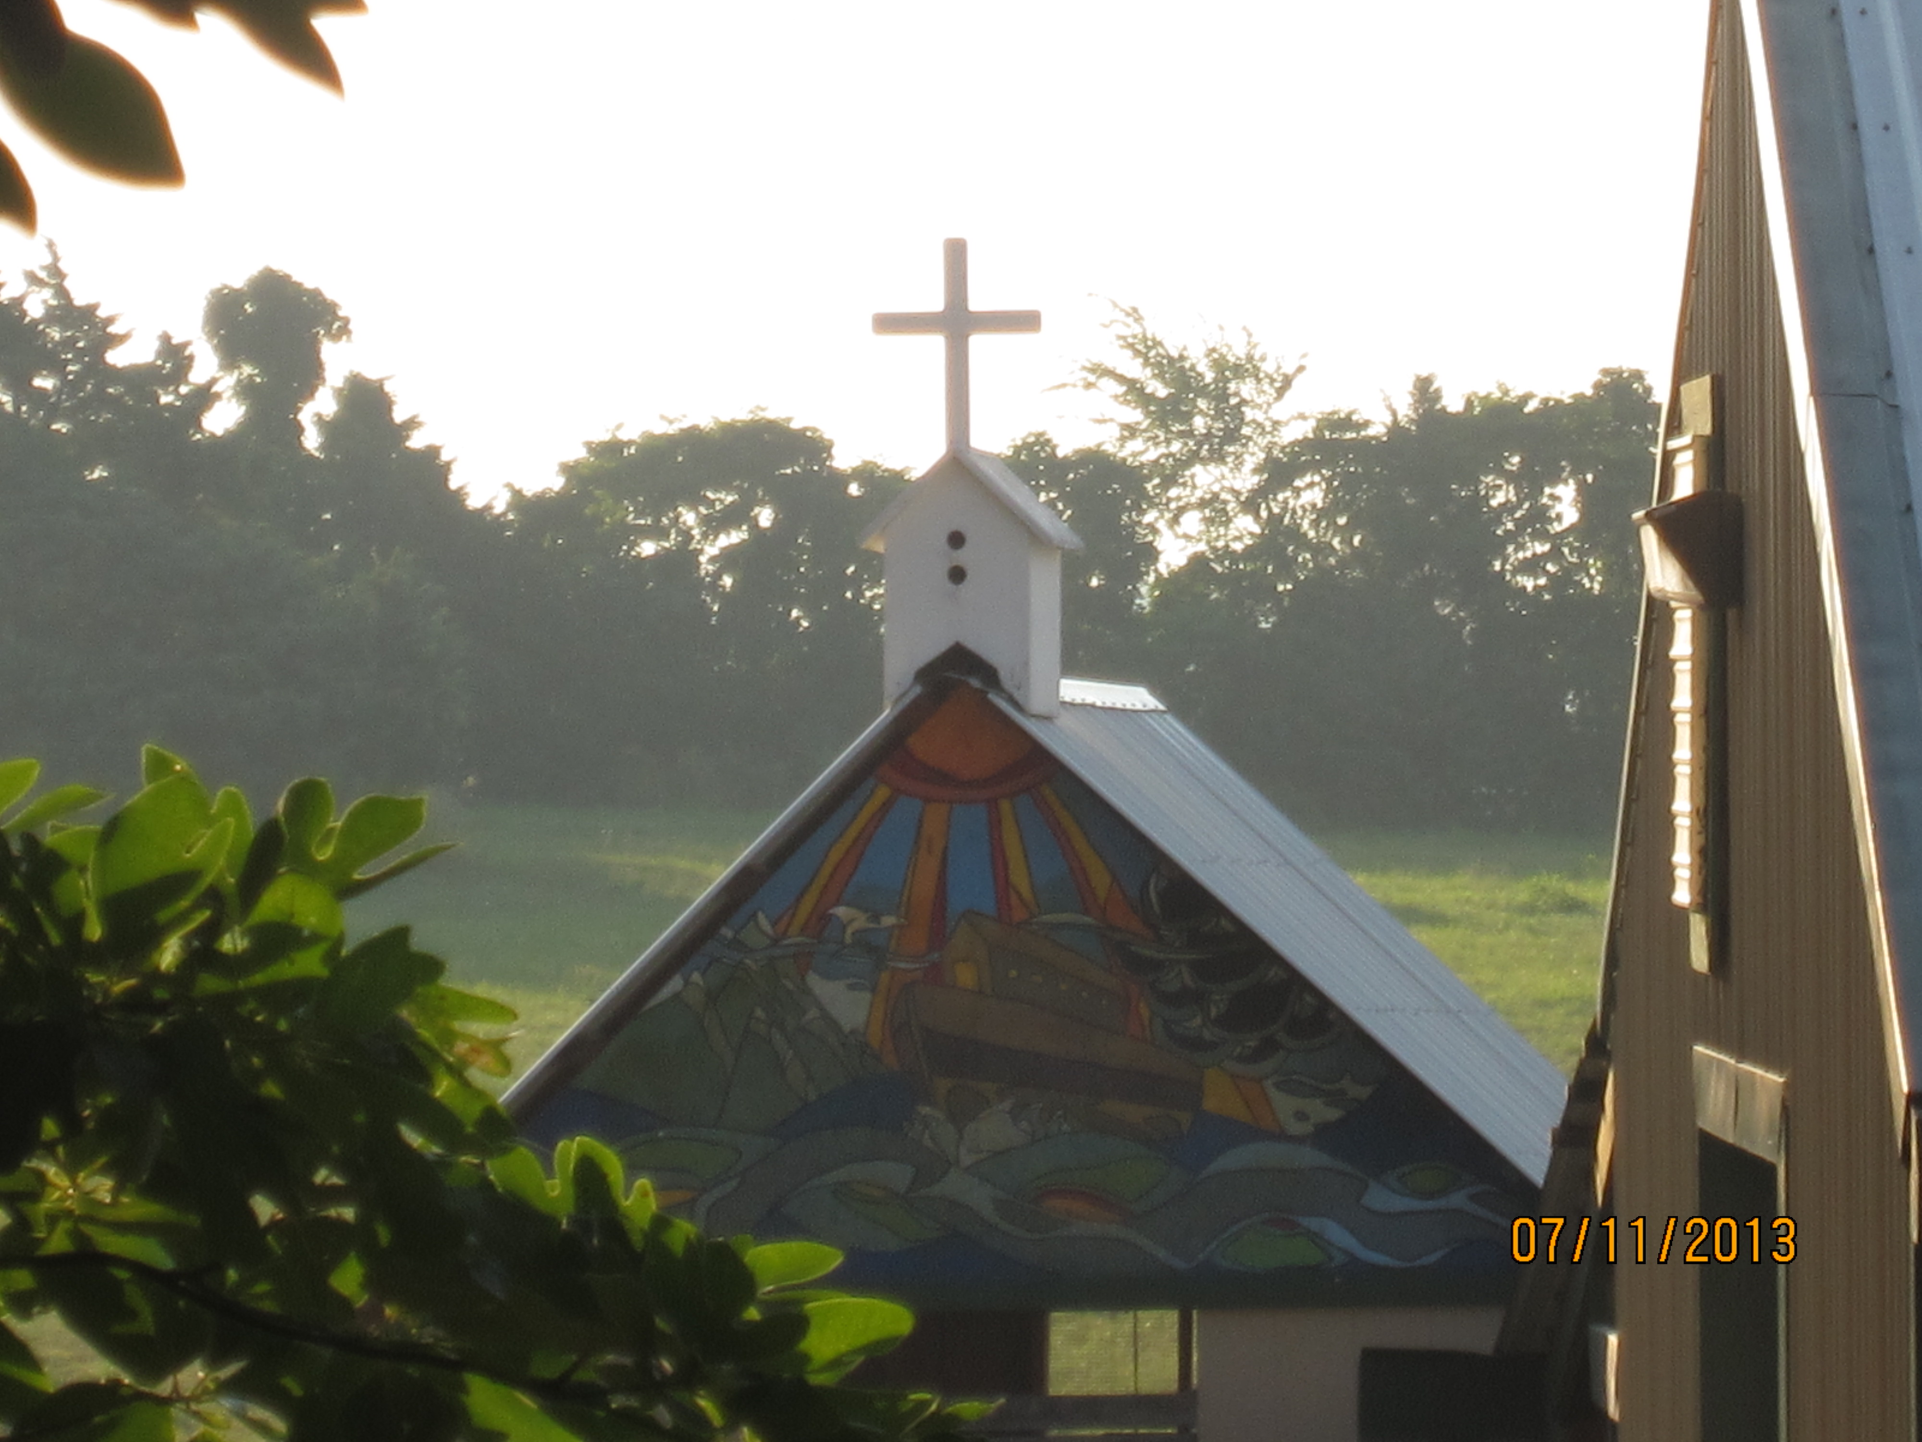
Hymn:
“Open My Eyes, That I May See”
# 454

Slide 28
Open my eyes, that I may see glimpses of truth thou hast for me;

Slide 29
Place in my hands the wonderful key that shall un-clasp and set me free.

Slide 30
Silently now I wait for thee, ready, my God, thy will to see.
Open my eyes, illumine me, Spirit divine!

Slide 31
Open my ears, that I may hear voices of truth thou sendest clear;

Slide 32
And while the wave-notes fall on my ear, everything false will disappear.

Slide 33
Silently now I wait for thee, ready, my God, thy will to see.
Open my ears, illumine me, Spirit divine!

Slide 34
Open my mouth, and let me bear gladly the warm truth everywhere;

Slide 35
Open my heart and let me prepare love thy children thus to share.

Slide 36
Silently now I wait for thee, ready, my God, thy will to see.
Open my heart, illumine me, Spirit divine!

Slide 37
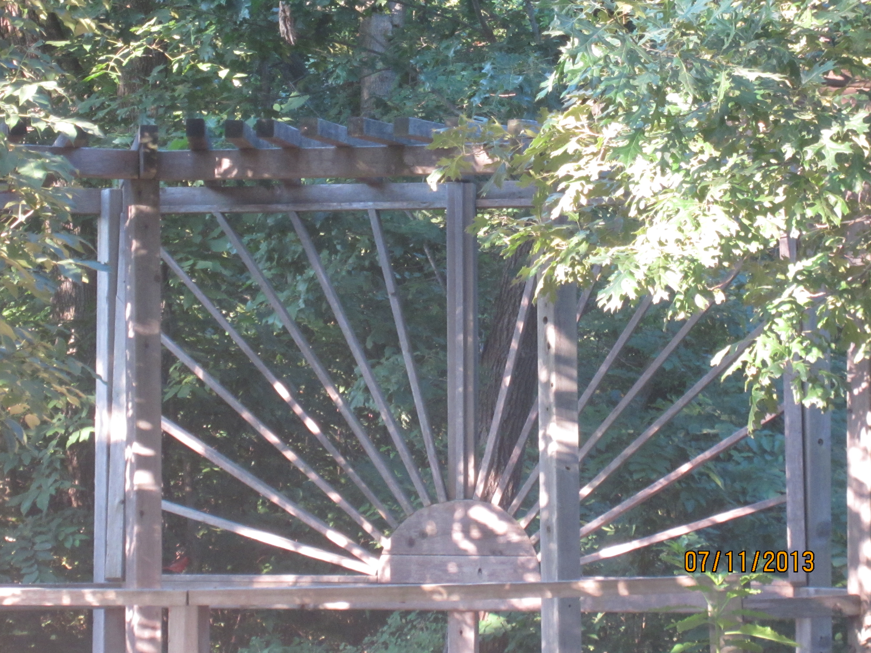
Scripture: from Mark 16:
¹⁵ And then he told them, “Go into all the world
and preach the Good News to everyone.

Slide 38
¹⁶ Anyone who believes
and is baptized
will be saved.
But anyone who refuses to believe will be condemned.

Slide 39
¹⁷ These miraculous signs will accompany those
who believe:
They will cast out demons
in my name,
and they will speak
in new languages.

Slide 40
¹⁸ They will be able to handle snakes with safety, and if they drink anything poisonous, it won’t hurt them.

Slide 41
They will be able to place their hands on the sick, and they will be healed.”

Slide 42
¹⁹ When the Lord Jesus had finished talking with them, he was taken up into heaven and sat down in the place of honor at God’s right hand.

Slide 43
²⁰ And the disciples went everywhere and preached, and the Lord worked through them, confirming what they said by many miraculous signs.

Slide 44
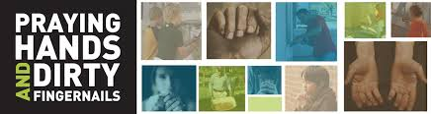
Completing God’s
Mission Work

Slide 45
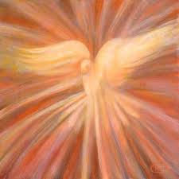
Hymn:
“O Breath of Life”
# 543

Slide 46
O Breath of Life, come sweeping through us, revive your church with life and power.

Slide 47
O Breath of Life, come cleanse, renew us, and fit your church to meet this hour.

Slide 48
O Wind of God, come, bend us, break us, till humbly we confess our need.

Slide 49
Then in your tenderness remake us, revive, restore, for this we plead.

Slide 50
O Breath of Love, come, breath within us, renewing thought and will and heart.

Slide 51
Come, love of Christ, a-fresh to win us; revive your church in every part.

Slide 52




Slide 53

Benediction
1st Peter 4:7-11

Slide 54
Everything in the world
is about to be wrapped up,
so take nothing for granted. Stay wide-awake in prayer.

Slide 55
Most of all,
love each other
as if your life
depended on it.
Love makes up
for practically anything

Slide 56
Be quick to give a meal
to the hungry,
a bed to the homeless—cheerfully.

Slide 57
Be generous with the different things God gave you, passing them around so all get in on it: if words, let it be God’s words; if help, let it be God’s hearty help.

Slide 58
That way,
God’s bright presence
will be evident
in everything
through Jesus,

Slide 59
and he’ll get all the credit
as the One mighty
in everything
—encores to the end
of time. Oh yes!

Slide 60
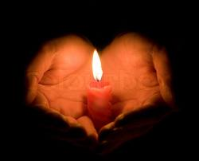
There’s a little flame inside us all
Some shine bright, some shine small
The rains will come and the waters rise
But don’t you ever lose your light

Slide 61
In this life you will know
Love and pain, joy and sorrow
So when it hurts, when times get hard
Don’t forget whose child you are

Slide 62
This little light of mine
I’m gonna let it shine
This little light of mine
I’m gonna let it shine, gonna let it shine

Slide 63
May you live each day with no regret
Make the most of every chance you get
Let your eyes get wide when you look at the stars

Slide 64
With the same sense of wonder as a child’s heart
With the ones you love treasure the time
And for those who are gone keep their memories alive

Slide 65
Hold on to your dreams don’t ever let go
There’s a fire inside you burning with hope

Slide 66
This little light of mine
I’m gonna let it shine
This little light of mine
I’m gonna let it shine, gonna let it shine

Slide 67
There will be days when you want to give up
When the clouds settle in
But after the rain comes the sun
Don’t you ever forget
Don’t forget, don’t forget

Slide 68
One day there will be no more pain
And we will finally see Jesus’ face
So until then I’m gonna to try
To brave the dark and let my little light shine

Slide 69
This little light of mine
I’m gonna let it shine
This little light of mine
I’m gonna let it shine, gonna let it shine
(REPEAT ONCE MORE)
Oh shine, gonna let it shine

Slide 70
There’s a little light inside us all

Slide 71


